Slide 1

Streaming Project Twitter Analysis

Slide 2
SPARK STREAMING example
Twitter Credential Setup
Since this exercise is based on Twitter’s sample tweet stream, it is necessary to configure authentication with a Twitter account. To do this, you will need to setup a consumer key+secret pair and an access token+secret pair using a Twitter account.
Go to link https://apps.twitter.com/

Slide 3
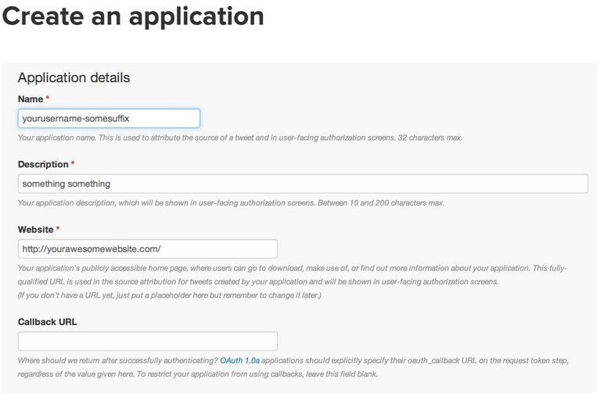
Create temporary application

Slide 4
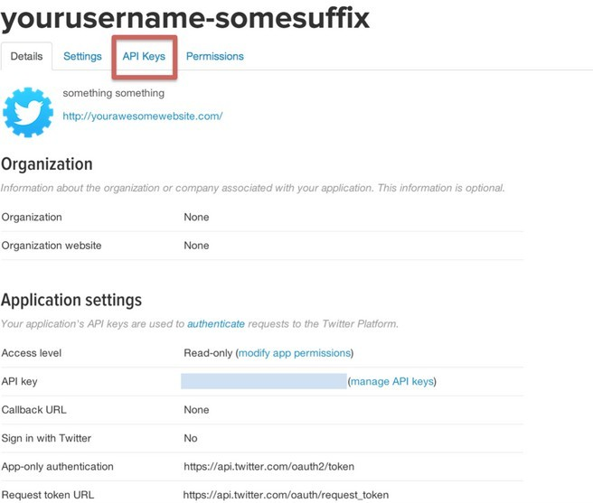

Slide 5
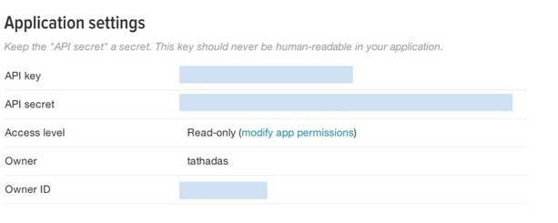
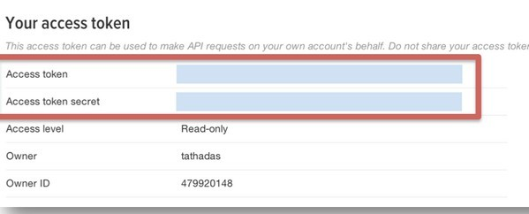
API keys

Slide 6
To express any Spark Streaming computation, a StreamingContext object needs to be created. This object serves as the main entry point for all Spark Streaming functionality

val ssc = new StreamingContext(new SparkConf(), Seconds(2))
We created a StreamingContext object by providing a Spark configuration, and the batch duration we’d like to use for streams

Slide 7

Get hashtags from Twitter
val tweets = TwitterUtils.createStream(ssc,twitterAuth,filters)
DStream: a sequence of RDDs representing a stream of data
Twitter Streaming API
batch @ t
batch @ t+1
batch @ t+2
tweets DStream
stored in memory as an RDD (immutable, distributed)
Note : Before going to start this application you need to have a twitter account and create
application keys like consumerKey,consumerSecret,accessToken,accessTokenSecret
System.setProperty("twitter4j.oauth.consumerKey", "FlRx3d0n8duIQ0UvGeGtTA") System.setProperty("twitter4j.oauth.consumerSecret", "DS7TTbxhmQ7oCUlDntpQQRqQllFFOiyNoOMEDD0lA") System.setProperty("twitter4j.oauth.accessToken", "1643982224-xTfNpLrARoWKxRh9KtFqc7aoB8KAAHkCcfC5vDk") System.setProperty("twitter4j.oauth.accessTokenSecret", "PqkbuBqF3AVskgx1OKgXKOZzV7EMWRmRG0p8hvLQYKs")

Slide 8
Get hashtags from Twitter
val tweets = TwitterUtils.createStream(ssc,twitterAuth,filters)
val getTags = (s:Status) => s.getHashtagEntities.toList.map(x => "#"+x.getText)
val hashTags = tweets.flatMap (status => getTags(status))
new DStream
transformation: modify data in one DStream to create another DStream
batch @ t
batch @ t+1
batch @ t+2
tweets DStream
flatMap
flatMap
flatMap
hashTags Dstream
[#cat, #dog, … ]
…
new RDDs created for every batch

Slide 9

Get hashtags from Twitter
val tweets = TwitterUtils.createStream(ssc,twitterAuth,filters)
val hashTags = streams.flatMap(status => status.getText.split(" ")).filter(_.startsWith("#"))
hashTags.saveAsTextFiles("hdfs://...")
output operation: to push data to external storage
batch @ t
batch @ t+1
batch @ t+2
tweets DStream
flatMap
flatMap
flatMap
hashTags DStream
save
save
save
every batch saved to HDFS

Slide 10
Count the hashtags
val tweets = TwitterUtils.createStream(ssc,twitterAuth,filters)
val hashTags = streams.flatMap(status => status.getText.split(" ")).filter(_.startsWith("#"))
val tagCounts = hashTags.countByValue().print()
batch @ t
batch @ t+1
batch @ t+2
tweets
flatMap
flatMap
flatMap
hashTags
…
map
map
map
tagCounts
[(#cat, 10), (#dog, 25), ... ]
reduceByKey
reduceByKey
reduceByKey

Slide 11
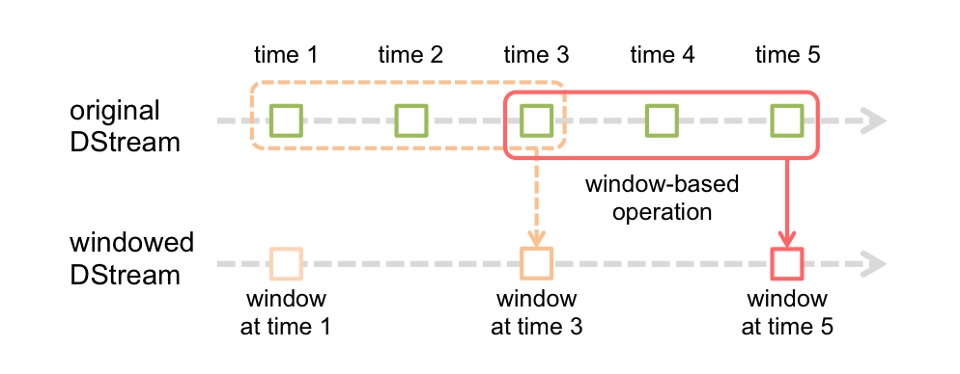
Window Operations
Spark Streaming also provides windowed computations, which allow you to apply transformations over a sliding window of data. The following figure illustrates this sliding window.
window length - The duration of the window
sliding interval - The interval at which the window operation is performed

Slide 12
Count the hashtags over last 10 mins
val tweets = TwitterUtils.createStream(ssc,twitterAuth,filters)
val hashTags = streams.flatMap(status => status.getText.split(" ")).filter(_.startsWith("#"))
val tagCounts = hashTags.window(Minutes(10),Seconds(5)).countByValue().print()
sliding window operation
window length
sliding interval
window length
DStream of data
sliding interval

Slide 13
Count the hashtags over last 10 mins
val tagCounts = hashTags.window(Minutes(10), Seconds(5)).countByValue()
t-5
t
t+5
t+10
t+15
hashTags
sliding window
countByValue
count over all the data in the window
tagCounts

Slide 14
Smart window-based countByValue
ssc.checkpoint("/user/cloudera/spark/streaming")
val tagCounts = hashtags.countByValueAndWindow(Minutes(10), Seconds(5))
t-5
t
t+5
t+10
t+15
hashTags
countByValue
add the counts from the new batch in the window
subtract the counts from batch before the window
–
+
tagCounts
+
?

Slide 15
Smart window-based reduce
Technique to incrementally compute count generalizes to many reduce operations
Need a function to “inverse reduce” (like “subtract” for counting)
Could have implemented counting as:
//Top hashTags with in the Batch interval of 60 Seconds and counting the HashTags by ReduceByKey Operation
val top60hashTags = hashTags.map(w => (w,1)).reduceByKeyAndWindow(_+_,Seconds(60))
//Top hashTags with in the Batch interval of 10 Seconds and counting the HashTags by ReduceByKey Operation
val top10hashTags = hashTags.map(w => (w,1)).reduceByKeyAndWindow(_+_,Seconds(10))

